Slide 1
Employee Data Analysis using Excel
STUDENT NAME:K.NARMADHA
REGISTER NO:312208407-asunm1330312208407
DEPARTMENT:B.COM(ACCOUNTING & FINANCE)
COLLEGE: CHELLAMMAL WOMEN’S COLLEGE, GUINDY CHENNAI

Slide 2
PROJECT TITLE
Employee Performance Analysis using Excel

Slide 3


AGENDA
Problem Statement
Project Overview
End Users
Our Solution and Proposition
Dataset Description
Modelling Approach
Results and Discussion
Conclusion
3/21/2024 Annual Review

Slide 4

PROBLEM STATEMENT
High Turnover: “High employee turnover suggests our performance review system may not be effectively addressing dissatisfaction.” Misaligned Metrics: “Current performance metrics do not align with organizational goals, causing confusion about employee impact on company success.” Inconsistent Feedback: “Declining productivity is not reflected in performance reviews, indicating potential issues with evaluation accuracy.” Perceived Bias: “Employees perceive bias in performance evaluations, leading to decreased morale and trust in the review process.”

Slide 5

PROJECT OVERVIEW
Employee performance analysis involves evaluating how well employees meet their job responsibilities and contribute to organizational goals. Key aspects include setting clear objectives, using performance metrics, conducting regular reviews, providing feedback, offering development opportunities, and recognizing achievements. The goal is to enhance productivity, improve job satisfaction, and align employee performance with organizational objectives.

Slide 6

WHO ARE THE END USERS?
Employees: Who receive feedback and development opportunities.
Managers: Who conduct evaluations and provide feedback.
HR Professionals: Who oversee the performance management process and ensure consistency.
Executives: Who use performance data to make strategic decisions and drive organizational goals.

Slide 7

OUR SOLUTION AND ITS VALUE PROPOSITION
Implement a comprehensive performance management system that includes clear goal setting, standardized metrics, regular evaluations, continuous feedback, and development plans.
Value Propositions:
Enhanced Clarity: Employees understand expectations and how their performance aligns with organizational goals.
Improved Performance: Regular feedback and development opportunities help employees improve and excel.
Increased Fairness: Standardized metrics and evaluations reduce bias and increase transparency.
Better Decision-Making: Accurate performance data supports strategic decisions and optimizes talent management.

Slide 8
Dataset Description
A dataset for employee performance analysis typically includes:
Employee Information: Basic details like name, role, and department.
Performance Metrics: Quantitative and qualitative measures such as productivity rates, quality of work, and goal achievement.
Evaluation Scores: Ratings from performance reviews, feedback from peers and managers.
Development Data: Records of training, skill development, and career progression.
Attendance and Punctuality: Data on work hours, absenteeism, and lateness.

Slide 9

THE "WOW" IN OUR SOLUTION
The “wow” in our solution is its ability to provide a comprehensive, transparent, and objective performance management system that aligns employee goals with organizational objectives, delivers actionable feedback, and supports continuous improvement and development. This leads to increased employee engagement, fair evaluations, and better overall performance.
3/21/2024 Annual Review
9

Slide 10
MODELLING
Modeling in employee performance analysis involves creating frameworks or algorithms to evaluate and predict employee performance based on data. This can include statistical models for assessing performance metrics, machine learning algorithms for predicting outcomes, and analytical models for identifying trends and patterns.
10

Slide 11
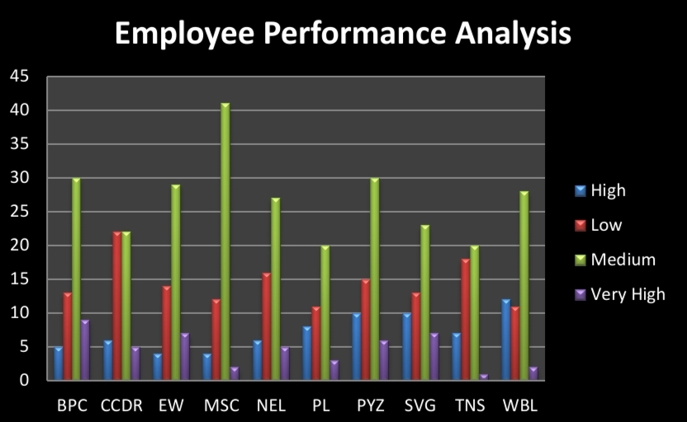
RESULTS
11

Slide 12
conclusion
In conclusion, effective employee performance analysis is crucial for aligning individual contributions with organizational goals, enhancing productivity, and fostering employee development. By implementing a robust performance management system with clear objectives, standardized metrics, and continuous feedback, organizations can ensure fair evaluations, improve performance, and make informed decisions that drive overall success.

